Slide 1
CHAPTER 12
Behavioral Finance and Technical Analysis

Slide 2
Behavioral Finance
Conventional Finance
Behavioral Finance
What if investors don’t behave rationally?
  Prices are correct; equal to intrinsic value.
  Resources are allocated efficiently.
  Consistent with EMH

Slide 3
The Behavioral Critique
Two categories of irrationalities:
  Investors do not always process information correctly.
    Result: Incorrect probability distributions of future returns.
  Even when given a probability distribution of returns, investors may make inconsistent or suboptimal decisions.
    Result: They have behavioral biases.

Slide 4
Errors in Information Processing: Misestimating True Probabilities
Forecasting Errors: Too much weight is placed on recent experiences.
Overconfidence: Investors overestimate their abilities and the precision of their forecasts.
Conservatism: Investors are slow to update their beliefs and under react to new information.
Sample Size Neglect and Representativeness: Investors are too quick to infer a pattern or trend from a small sample.

Slide 5
Behavioral Biases
Biases result in less than rational decisions, even with perfect information.
Examples:
Framing:
  How the risk is described, “risky losses” vs. “risky gains”, can affect investor decisions.

Slide 6
Behavioral Biases
Mental Accounting:
  Investors may segregate accounts or monies and take risks with their gains that they would not take with their principal.
Regret Avoidance:
  Investors blame themselves more when an unconventional or risky bet turns out badly.

Slide 7
Behavioral Biases
Prospect Theory:
  Conventional view: Utility depends on level of wealth.
  Behavioral view: Utility depends on changes in current wealth.

Slide 8
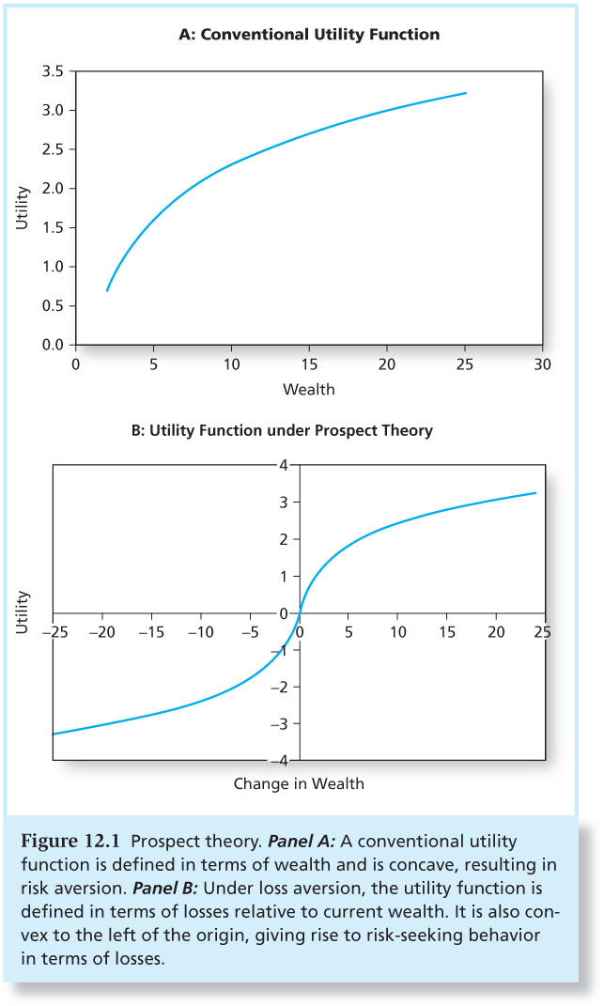
Figure 12.1 Prospect Theory

Slide 9
Limits to Arbitrage
Behavioral biases would not matter if rational arbitrageurs could fully exploit the mistakes of behavioral investors.
Fundamental Risk:
  “Markets can remain irrational longer than you can remain solvent.”
  Intrinsic value and market value may take too long to converge.

Slide 10
Limits to Arbitrage
Implementation Costs:
  Transactions costs and restrictions on short selling can limit arbitrage activity.
Model Risk:
  What if you have a bad model and the market value is actually correct?

Slide 11
Limits to Arbitrage and the
Law of One Price
Siamese Twin Companies
  Royal Dutch should sell for 1.5 times Shell
  Have deviated from parity ratio for extended periods
  Example of fundamental risk

Slide 12
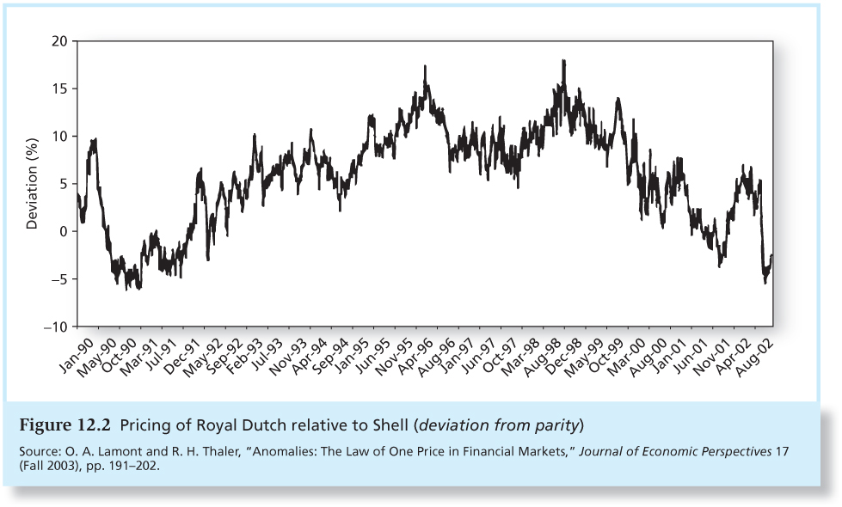
Figure 12.2 Pricing of Royal Dutch Relative to Shell (Deviation from Parity)

Slide 13
Limits to Arbitrage and the
Law of One Price
Equity Carve-outs
  3Com and Palm
  Arbitrage limited by availability of shares for shorting
Closed-End Funds
  May sell at premium or discount to NAV
  Can also be explained by rational return expectations

Slide 14
Bubbles and Behavioral Economics
Bubbles are easier to spot after they end.
  Dot-com bubble
  Housing bubble

Slide 15
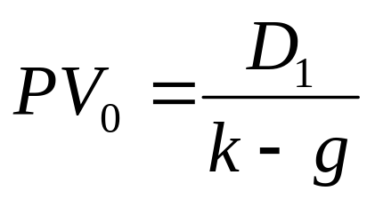
Bubbles and Behavioral Economics
Rational explanation for stock market bubble using the dividend discount model:
  S&P 500 is worth $12,883 million if dividend growth rate is 8% (close to actual value in 2000).
  S&P 500 is worth $8,589 million if dividend growth rate is 7.4% (close to actual value in 2002).

Slide 16
Technical Analysis and Behavioral Finance
Technical analysis attempts to exploit recurring and predictable patterns in stock prices.
  Prices adjust gradually to a new equilibrium.
  Market values and intrinsic values converge slowly.

Slide 17
Technical Analysis and Behavioral Finance
Disposition effect: The tendency of investors to hold on to losing investments.
  Demand for shares depends on price history
  Can lead to momentum in stock prices

Slide 18
Trends and Corrections:
The Search for Momentum
Dow Theory
Primary trend : Long-term movement of prices, lasting from several months to several years.
Secondary or intermediate trend: short-term deviations of prices from the underlying trend line and are eliminated by corrections.
Tertiary or minor trends: Daily fluctuations of little importance.

Slide 19
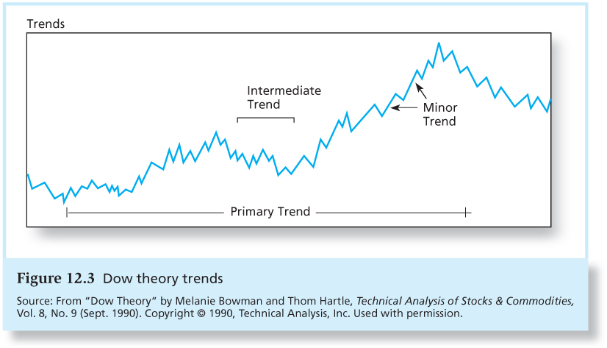
Figure 12.3 Dow Theory Trends

Slide 20
Trends and Corrections: Moving Averages
The moving average is the average level of prices over a given interval of time.
Bullish signal: Market price breaks through the moving average line from below. Time to buy
  Bearish signal: When prices fall below the moving average, it is time to sell.

Slide 21
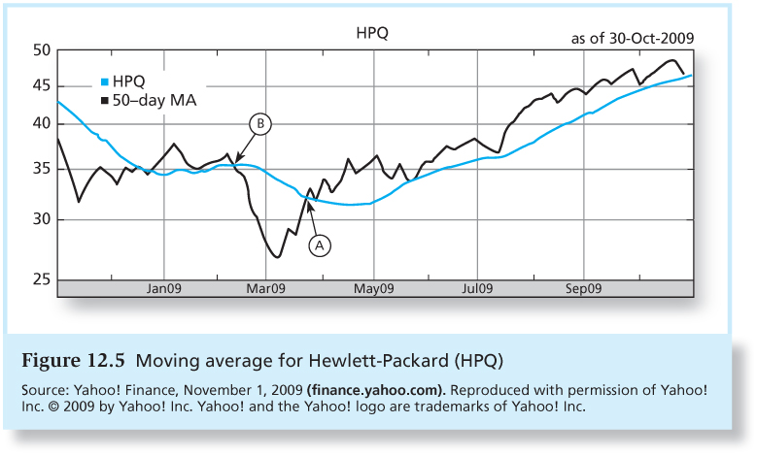
Figure 12.5 Moving Average for HPQ

Slide 22
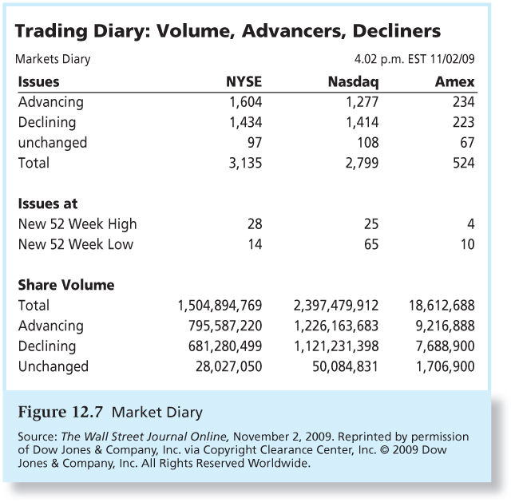
Trends and Corrections: Breadth
Breadth: Often measured as the spread between the number of stocks that advance and decline in price.

Slide 23
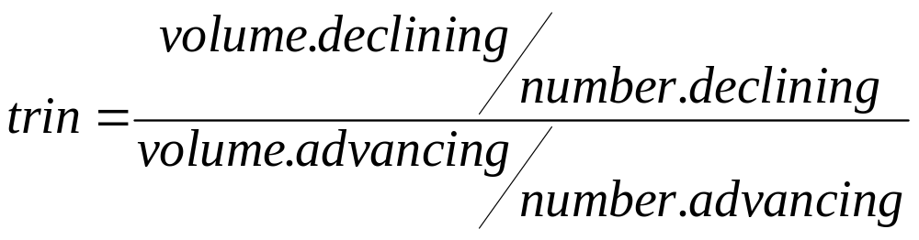
Sentiment Indicators:
Trin Statistic
Trin Statistic:
  Ratios above 1.0 are bearish

Slide 24
Sentiment Indicators:
Confidence Index
Confidence index: The ratio of the average yield on 10 top-rated corporate bonds divided by the average yield on 10 intermediate-grade corporate bonds.
Higher values are bullish.

Slide 25
Sentiment Indicators:
Put/Call Ratio
Calls are the right to buy.
  A way to bet on rising prices
Puts are the right to sell.
  A way to bet on falling prices
A rising ratio may signal investor pessimism and a coming market decline.
Contrarian investors see a rising ratio as a buying opportunity!

Slide 26
Warning!
It is possible to perceive patterns that really don’t exist.
Figure 12.8A is based on the real data. The graph in panel B was generated using “returns” created by a random-number generator.
Figure 12.9 shows obvious randomness in the weekly price changes behind the two panels in Figure 12.8

Slide 27
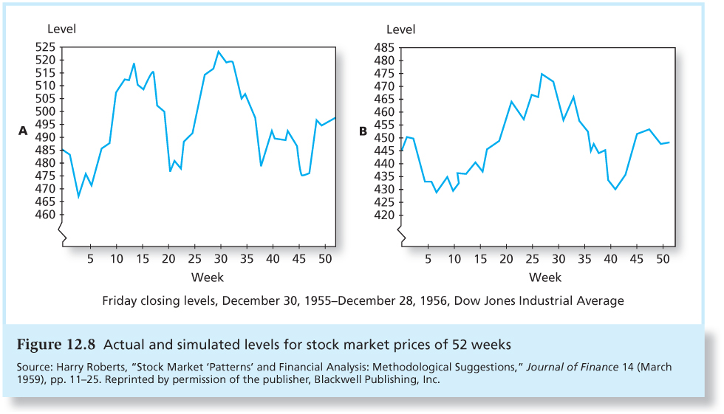
Figure 12.8 Actual and Simulated Levels for Stock Market Prices of 52 Weeks

Slide 28
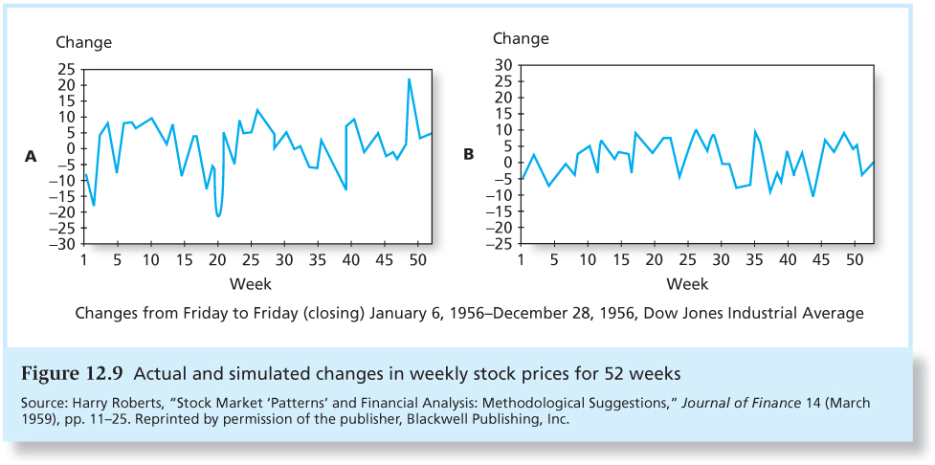
Figure 12.9 Actual and Simulated Changes in Stock Prices for 52 Weeks

